Slide 1
Welcome! Please copy the content on the usb drive to your laptop,
or download from sources
What’s in the usb drive:
1. A software platform we’ll run ipython notebook on. Please copy & install the version suitable to your OS (Windows, Mac, Linux). https://www.anaconda.com/download/
2. A dataset we’ll play with in the second half of the workshop. https://www.yelp.com/dataset/
3. A sample source code we’ll cover in the second half of the workshop. https://goo.gl/WgoeUL

Slide 2
A Hands-on Dive into
Making Sense of Real World Data
Jamie Whitacre | @JupyterJW
Xun Tang | @whoisxun | xun@yelp.com
Notes:
My name, i am a s/w engineer working at yelp
Topic today is …
Walk thru an example and getting ...
Basic python knowledge && laptop

Slide 3
Plan for Today
-1-
Install Jupyter
-2-
Learn how to use it
-3-
Complete a machine learning case study
using the Jupyter Notebook & Yelp data
Jupyter is great for learning and doing Python!
Basic knowledge of Python is assumed today
as is high school level math and statistics
Notes:
Good Morning. Thanks to all of you for waking up relatively early on the last day to check out our talk. Thanks to the Grace Hopper organizers for having us here today.
Today we’ll be talking about Project Jupyter, Yelp, data science, and within that, machine learning.
Hopefully you already have your Anaconda distribution installing - if you do not, please go ahead and get that going now.
Other installation platforms:
https://conda.io/miniconda.html
https://notebooks.azure.com/
https://nteract.io/desktop - open notebooks natively on Mac, PC, Linux
http://zero-to-jupyterhub.readthedocs.io/en/latest/

Slide 4
By the End of the Workshop, You Will Be Able To. . .
Explain the value of using Jupyter Notebooks for data analysis as an individual or on a team.
Use Pandas and other Python libraries to perform common data analysis and machine learning tasks.
Solve a simple modeling problem adapted from a real-world problem and data set.
Notes:
BY THE END OF THE WORKSHOP
BE ABLE TO . . .
Explain the value of using Jupyter Notebooks for data analysis as an individual or on a team.
Use Pandas and other Python libraries to perform common data analysis and machine learning tasks.
Solve a simple modeling problem adapted from a real-world problem and data set.

Slide 5


About us
Jamie
Xun
Notes:
About US
I’m Jamie. I worked as the Technical Project Manager for the Jupyter Team out of the Berkeley Institute for Data Science. And recently stepped away from working full-time on the project to do a Data Science immersive program.
I have a background in Bioinformatics and data systems design & engineering in industry and in academia.
Xun -

Slide 6
Jupyter Notebook
Is the evolution of the IPython Notebook into a language agnostic computing environment supporting 60+ programming languages including Python, R, Julia, and many others.
Notes:
JUPYTER NOTEBOOK
Is the evolution of the IPython Notebook into a language agnostic computing environment supporting 60+ programming languages [NEXT SLIDE] including Python, R, Julia, and many others.

Slide 7
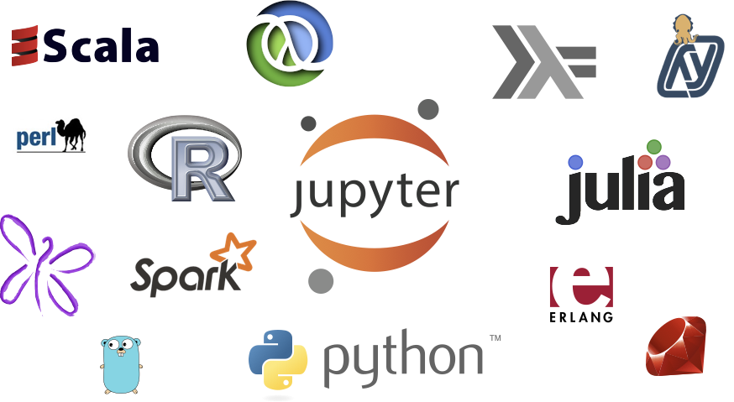
Jupyter Protocol is Language Agnostic
Notes:
Is the evolution of the IPython Notebook into a language agnostic computing environment supporting 60+ programming languages including Python, R, Julia, and many others
The cool and amazing thing about these kernels is that the Jupyter team has not written the vast majority of them- they’ve been developed by the communities that own them based on Jupyter’s open protocol.

Slide 8
Jupyter Notebook
Is the evolution of the IPython Notebook into a language agnostic computing environment supporting 60+ programming languages including Python, R, Julia, and many others.
A digital “document” that gives you a way to record your thoughts, CODE, and visualizations in a single place
A tool to explore, understand, communicate, and tell stories about your data in a systematic and reproducible way
Provides access to many, many Python libraries
Notes:
JUPYTER NOTEBOOK
Is the evolution of the IPython Notebook into a language agnostic computing environment supporting 60+ programming languages including Python, R, Julia, and many others.
A digital “document” that gives you a way to record your thoughts, CODE, and visualizations in a single place

Slide 9
Jupyter Notebook
Is the evolution of the IPython Notebook into a language agnostic computing environment supporting 60+ programming languages including Python, R, Julia, and many others.
A digital “document” that gives you a way to record your thoughts, CODE, and visualizations in a single place
A tool to explore, understand, communicate, and tell stories about your data in a systematic and reproducible way
Provides access to many, many Python libraries
Notes:
JUPYTER NOTEBOOK
Is the evolution of the IPython Notebook into a language agnostic computing environment supporting 60+ programming languages including Python, R, Julia, and many others.
A digital “document” that gives you a way to record your thoughts, CODE, and visualizations in a single place
A tool to explore, understand, communicate, and tell stories about your data in a systematic and reproducible way

Slide 10
Jupyter Notebook
Is the evolution of the IPython Notebook into a language agnostic computing environment supporting 60+ programming languages including Python, R, Julia, and many others.
A digital “document” that gives you a way to record your thoughts, CODE, and visualizations in a single place
A tool to explore, understand, communicate, and tell stories about your data in a systematic and reproducible way
Provides access to many, many Python libraries
Notes:
JUPYTER NOTEBOOK
Is the evolution of the IPython Notebook into a language agnostic computing environment supporting 60+ programming languages including Python, R, Julia, and many others.
A digital “document” that gives you a way to record your thoughts, CODE, and visualizations in a single place
A tool to explore, understand, communicate, and tell stories about your data in a systematic and reproducible way
Provides access to many, many Python libraries

Slide 11
A Tool for Interactive Computing
A dialogue between the human and the computer.
Assemble ideas using the computer as playground, as “data microscope.”
A way to assemble the building blocks of scientific computing and data science.
Notes:
The heart of Jupyter is interactive computing, a dialogue between the human and the computer; like using the computer as a data microscope to inspect the edges and the idiosyncrasies of your data set.
A way to assemble the building blocks of scientific computing and data science
—-

Slide 12
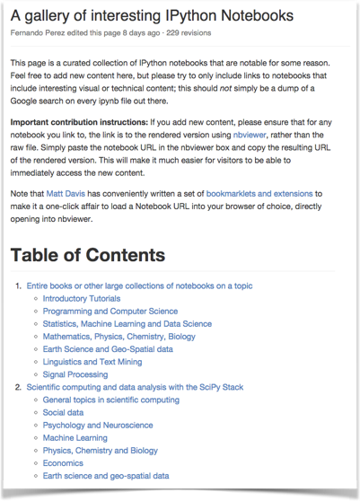
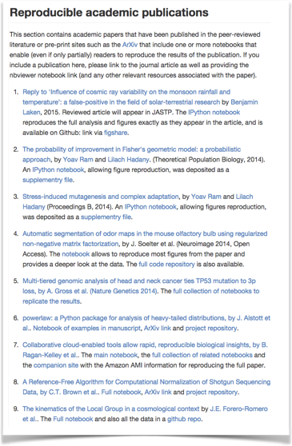
Learn Through Examples:
Gallery of Interesting Jupyter Notebooks
Notes:
The best way to learn how to create great Jupyter Notebooks is by Example.
If you Google “The Gallery of Interesting Jupyter Notebooks” you’ll see how Jupyter is used across academic disciplines and industries. You can download many of these notebooks and try them out yourself locally.

Slide 13
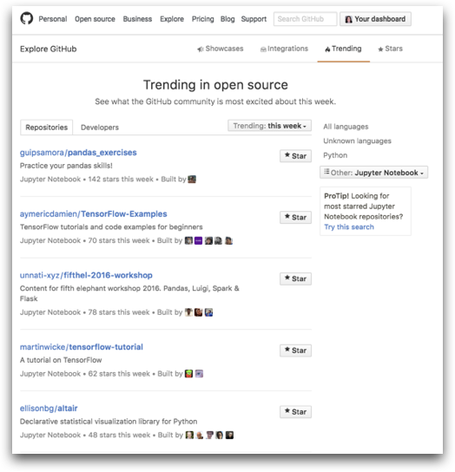

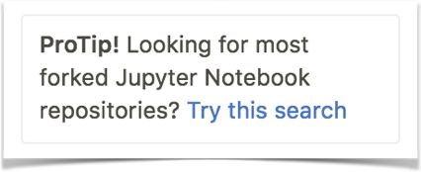
Over 500K Notebooks on GitHub
CHECK OUT “TRENDING REPOSITORIES”
https://github.com/trending/jupyter-notebook?since=weekly
Notes:
Many of these notebooks live on GitHub where they rendered natively. There are now over 500K notebooks searchable within GitHub.
To find them use GitHub’s “Explore GitHub” tool. There you can search for trending notebooks by day, week, and month - a great way to track interesting content created in Jupyter Notebooks and to learn from active Jupyter users.

Slide 14
Jupyter in the Wild
Open source - which means anyone can download it and use it for free.
Digital Journalism, Scientific research, Commercial products, Classrooms, Coding Bootcamps, Online Learning, Conferences, Data Engineering Pipelines, High Performance Computing (HPC) . . .
Physics, Astronomy, Biology, Economics & Finance, Social Sciences, Geo Sciences, Digital Humanities . . .
Commercial big data platforms: Microsoft, IBM, Google, Bloomberg, more . . .
Notes:
In many spaces, where there’s data, there’s Jupyter running at some level. [READ SLIDE]
Open source - which means anyone can download it and use it for free.
Digital Journalism, Scientific research, Commercial products, Classrooms, Coding Bootcamps, Online Learning, Conferences, Data Engineering Pipelines, High Performance Computing (HPC) . . .
Physics, Astronomy, Biology, Economics & Finance, Social Sciences, Geo Sciences, Digital Humanities . . .
Commercial big data platforms: Microsoft, IBM, Google, Bloomberg, more . . .

Slide 15
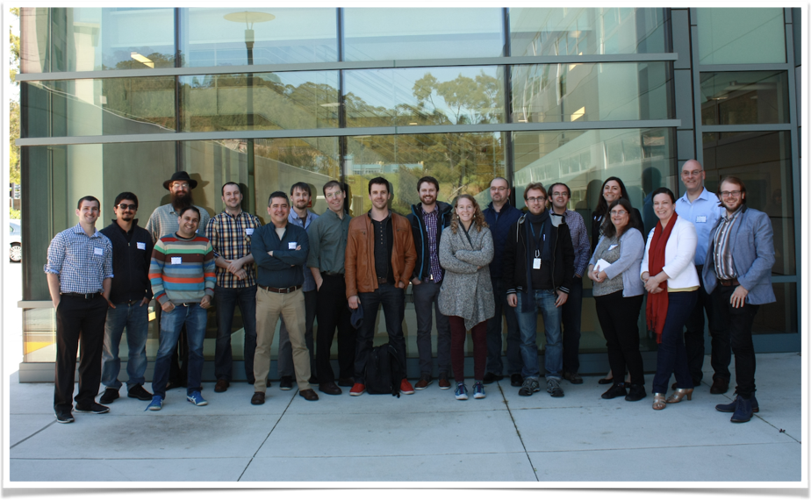
The Jupyter Team
Notes:
Project Jupyter is an ecosystem of tools built by a global team of scientists, researchers, and developers over 15 years in the making but the team is actually fairly small- about 18-25 core contributors at any time.
The project has had a long history in the scientific computing community and has benefited from contributions from over 500 volunteer scientists and developers [NEXT SLIDE] in academia, industry and beyond. These are the people who have made this project possible.

Slide 16
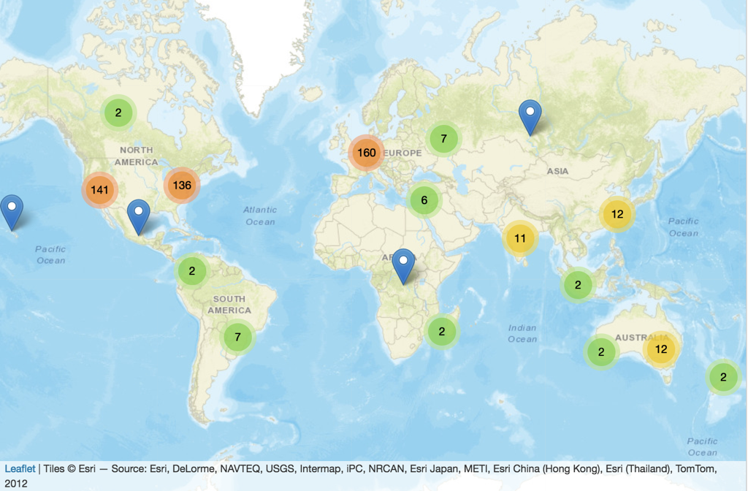
~500 Committers to
IPython/Jupyter Repositories
By Stuart Geiger, Jamie Whitacre, Matthias Bussonnier, and Nami Saghaei
Notes:
Project Jupyter is an ecosystem of tools built by a global team of scientists, researchers, and developers over 15 years in the making. The project has had a long history in the scientific computing community and has benefited from contributions from over 500 volunteer scientists and developers in academia, industry and beyond. These are the people who have made this project possible.

Slide 17
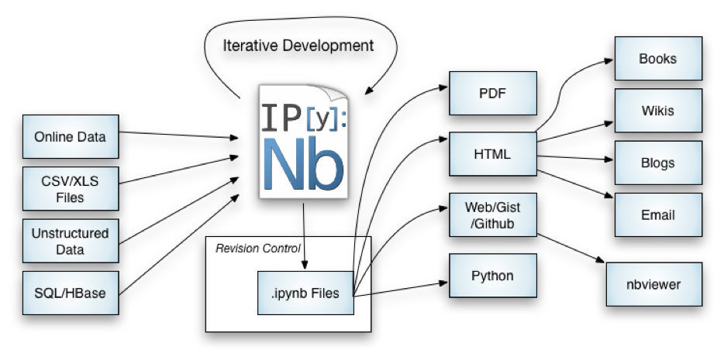

Notebook Workflows: The Big Picture
Notes:
So Let’s take a look at the Jupyter ecosystem.
Part of the ecosystem deals with working with the Notebooks.
Joshua Barrat created this nice diagram of IPython inputs and outputs that I’ve modified slightly by adding the Jupyter logo. I think its a useful diagram for individuals and data science teams designing and building out their own workflows.
The main intent of showing you this diagram is to convey that Jupyter has really changed the way people interact with data. You can load many types of data into the Jupyter notebook, be it text data, videos, sound recordings, etc.; and use the notebook to immerse yourself in the world of analysis and then, when you’re ready; communicate that analysis to your colleagues and/or out to the world.

Slide 18
Let’s Get Started

Slide 19
Navigation
and Basic Commands
Notes:
Hopefully by this time you’ve successfully installed the Anaconda distribution. Let’s see a show of hands of who’s got it and who does not.
Please go sit with each other - we’ll take 3 minutes for you to organize yourselves.

Slide 20

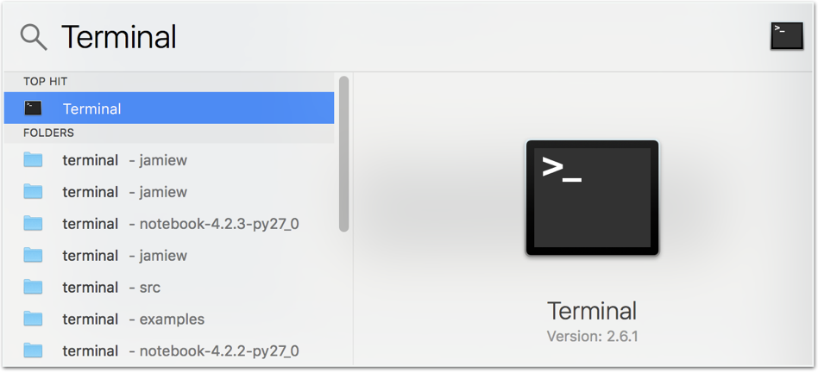
Notes:
Once you’ve installed Jupyter, open up your terminal, navigate to a directory you want to work out of, and type in “jupyter notebook”

Slide 21
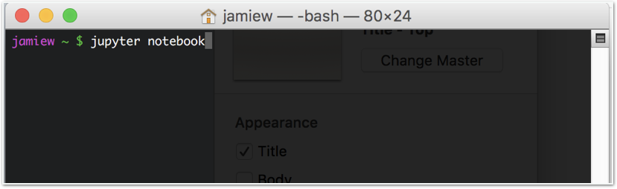

Slide 22
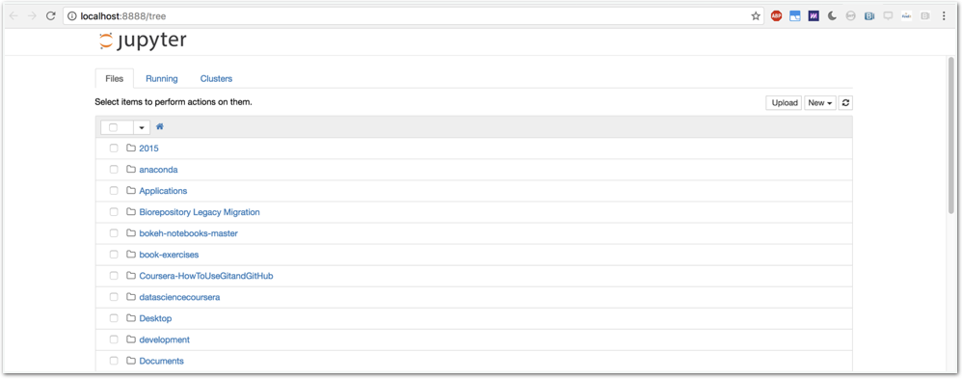
Notes:
This should bring up a window into your home directory where you can navigate to an existing notebook or where you’d like to store a new notebook.
Let’s create a new notebook.

Slide 23
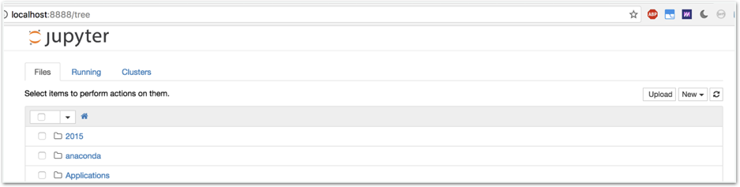

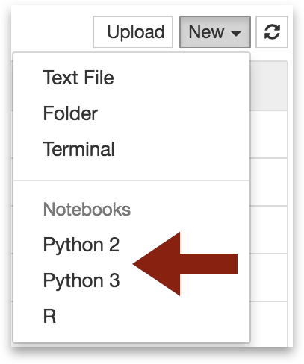
Notes:
Go ahead and click on “New” in the upper right hand side of the window.
From the drop-down menu, you’ll be able to select the kernel you want to use- Python 2 or Python 3. For the time being, let’s think of “kernel” as the programming language you want to use. [NEXT SLIDE]

Slide 24

http://wikiclipart.com/candy-corn-clipart_1783/
Notes:
Yay Kernels!

Slide 25
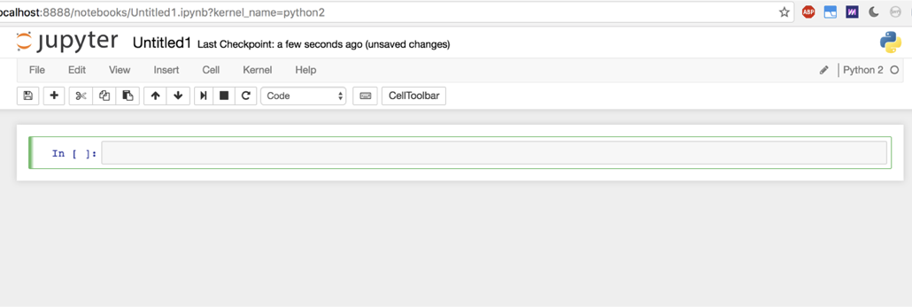
Notes:
Once you’ve selected your kernel, a notebook ‘document’ will come up.
Today we’ll start to build a warm-up notebook in preparation for the Yelp case study

Slide 26
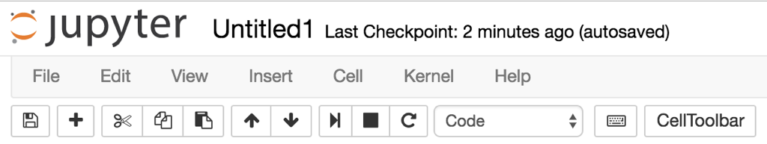
Notes:
Each of the icons in the toolbar will help you do something in your notebook.
Let’s click Help in the Menu Bar for a quick tour of the notebook. Go ahead and put up a green sticky once you’re done with the tour.
Starting from the left and moving right:
Disk
Plus
Scissors
Copy
Paste
Move up
Move down
Run the kernel
Stop the kernel
Re-start the kernel
Choose a cell type
Keyboard shortcuts
CellToolbar

Slide 27
Warm Up
#Define a variable
x = 5
print(x)
Notes:
Go ahead and type what you see on the screen in your first code cell and then hit Shift + Enter

Slide 28
Importing Libraries

Slide 29
Importing Libraries
import ____ as _____
CONVENTIONS
import matplotlib.pyplot as plt
%matplotlib inline
import pandas as pd
import seaborn as sns
from sklearn import ______
Notes:
Python libraries, sometimes called packages or modules are pre-made collections of functions that allow you to do powerful work.
Today we’ll be using matplotlib, pandas, seaborn, and scikit-learn.

Slide 30
Pandas
Notes:
Pandas is build on top of NumPy and is great for data munging.

Slide 31
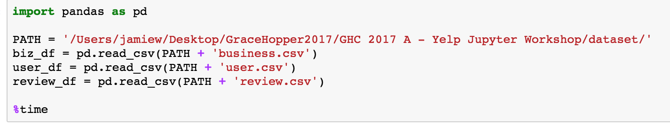
Reading in Data
Reading data in / querying data sources / writing data out
Notes:
Pandas also gives you the opportunity to read in data, query data sources and write data out of your IPython environment.
Here, we’re going to use the import convention “import pandas as pd”
Then let’s just import the review data. Let’s set a variable name for our data frame : review_df

Slide 32
Did it work?
Notes:
Did it work?

Slide 33
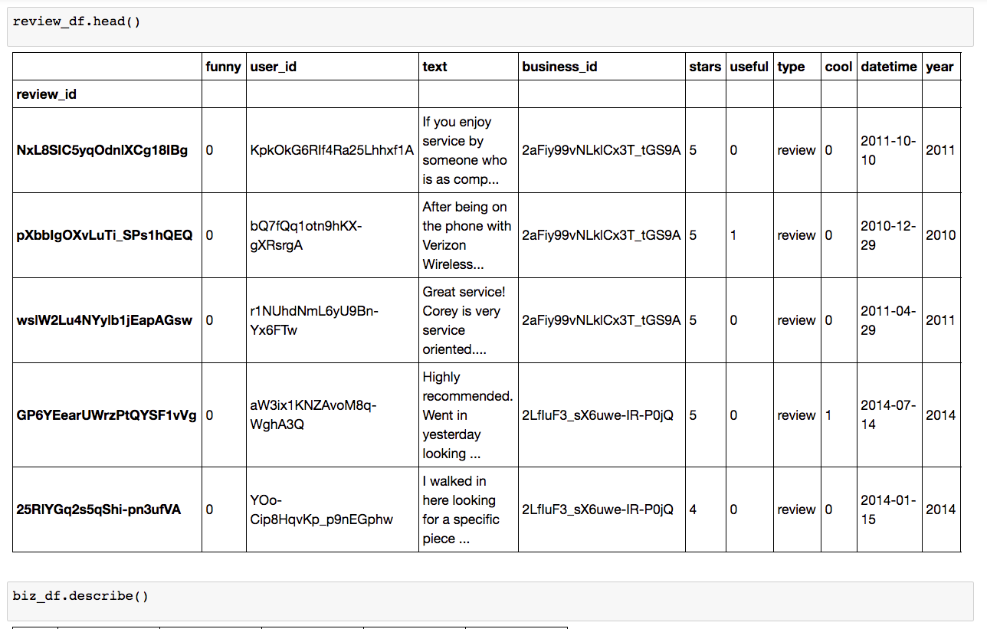
Did it work?
Notes:
Let’s create a new code cell and type in “review_df.head()” to look at the first five rows of the dataframe.
Looks ok . . .

Slide 34
Did it work?
Notes:
Let’s create a new code cell and type in “review_df.head()” to look at the first five rows of the dataframe.
Looks ok . . .

Slide 35
Pandas
http://pandas.pydata.org/pandas-docs/stable/10min.html
github.com/jehuston/pandas_tutorial/blob/master/pandas_tutorial.ipynb
https://github.com/brandon-rhodes/pycon-pandas-tutorial
Notes:
To get more practice with Pandas, I recommend these tutorials (I’ll leave it up for a minute)

Slide 36
Making Charts

Slide 37
Making Charts with Matplotlib
http://matplotlib.org/users/screenshots.html#simple-plot
Simple plot
Histograms
Bar Charts
Scatter plots
Other great plotting libraries: plot.ly,, Altair, Bokeh
Notes:
One of the primary and foundational plotting libraries in the Jupyter ecosystem is matplotlib. It will give you some decent charts out of the gate.
Please go to this website above: [READ IT OUTLOUD]
Matplotlib should have installed with your Anaconda distribution.

Slide 38
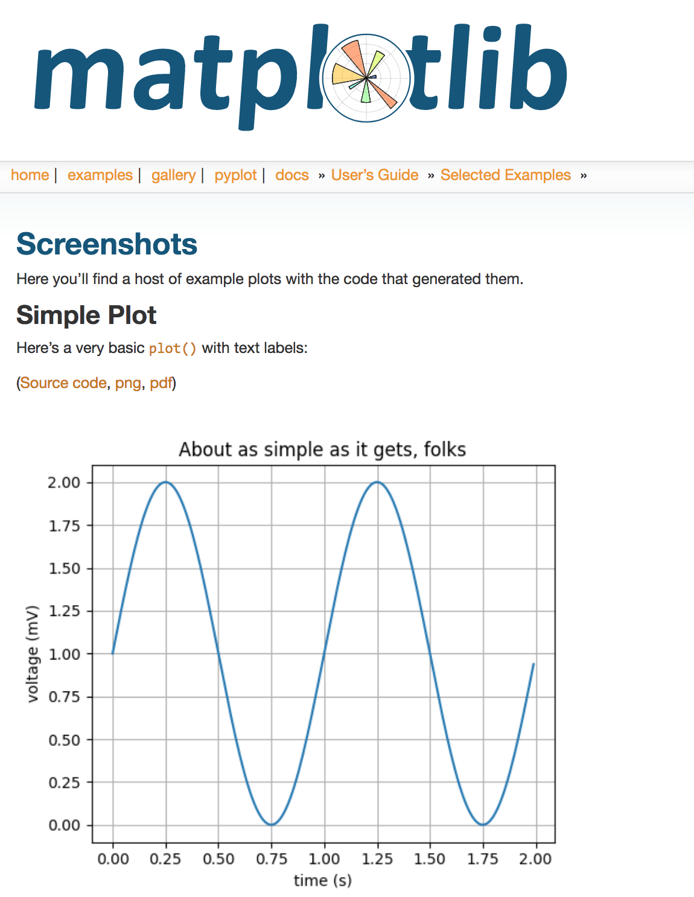
Notes:
When you arrive at the matplotlib webpage, you’ll see a series of plots. Above each plot, is a link to the source code which you can download and open in a text editor.
Later in the workshop, you’ll work with Xun to create histograms of the Yelp data.

Slide 39
Making Charts with Matplotlib
Other great plotting libraries: plot.ly, Seaborn, Altair, Bokeh
Remember to use ‘%matplotlib inline’ to display your plot in your notebook
Notes:
One of the primary and foundational plotting libraries in the Jupyter ecosystem is matplotlib. It will give you some decent charts out of the gate.
Matplotlib should have installed with your Anaconda distribution.

Slide 40
Case Study:
The Yelp Dataset

Slide 41
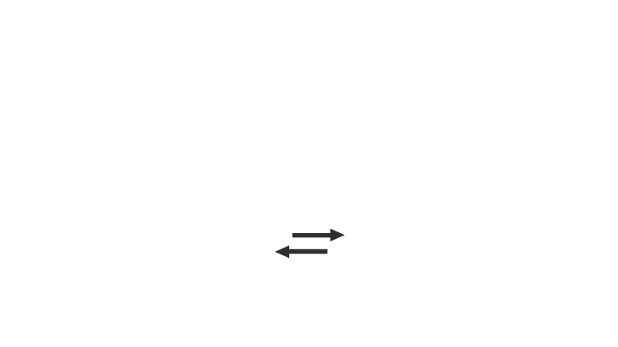


Yelp’s Mission
Connecting people with great
local businesses.
Notes:
show hands, how many uses yelp
Yelp is a website and mobile app that connects people with great local businesses.

Slide 42
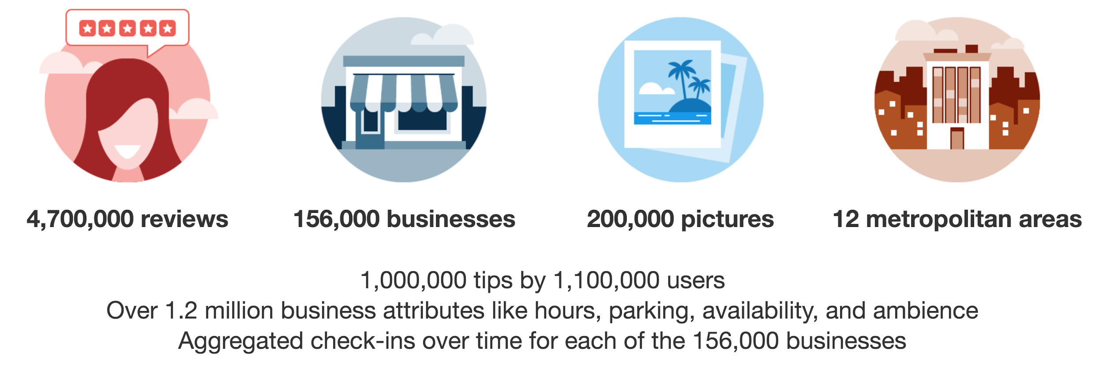
Yelp Open Dataset yelp.com/dataset
yelp.com / dataset
Notes:
show hands, how many heard of yelp open dataset
An all-purpose dataset for learning, accessible to everyone
goal: provide a dataset for either personal or educational purpose, so that folks can learn from a realistic dataset.
a few numbers:
over 12 metropolitan areas
in the dataset, there are 4.7 million reviews, over 1 million users, hundreds of thousands of businesses, checkins, photos, etc

Slide 43








Given users’ past reviews on Yelp
When the user writes a review for a business she hasn't reviewed before
Will it be a review? (True / False)
Open Dataset
Notes:
second half, walk thru case study
demo how to solve a sample data science problem using the tools jamie just told you about
Jupyter Notebooks, and the tools mentioned above: seaborn, pandas, scikit learn, etc.
problem statement
what?
five star: yelp’s star rating system for reviews, 1-5. a review either a 5-star review, or not a 5-star review.
answer to q is true/false.
in ml called a classification problem.
you might say
we don’t know what experience the user would’ve have with the biz .it’s something in the future, hasn’t happen
but we’d like to predict
as a human being, if you were asked this question (whether a future experience five star or not), how would you do it?
biz’s past reviews, are they 5 star or not?
look at the user’s past reviews, are they 5 star or not? finer granularity, users likes chinese food, biz is a chinese restaurant, higher chance it’s a 5 star review
look at the past, educated guess
same idea can be applied to a machine-learning process
given info from yelp open dataset, predict whether something will happen or not. classification.
specifically, user, biz, review

Slide 44
To Solve a Data Science Problem
Step 1: Load the Data
Step 2: Explore and Visualize the Data
Step 3: Generate the Features
Step 4: Train a Model
Step 5: Evaluate the Model
Step 6 & Beyond: Iterate Through the Process
Notes:
design case study to walk thru the common steps to solve a ds problem
the full ipynb available on GitHub link, shown on the slides are highlights. up to you
step 4: The process of training an ML model involves providing an ML algorithm (that is, the learning algorithm) with training data to learn from. The term ML model refers to the model artifact that is created by the training process.

Slide 45
Step 1
Load the Data
Notes:
let’s get started!

Slide 46
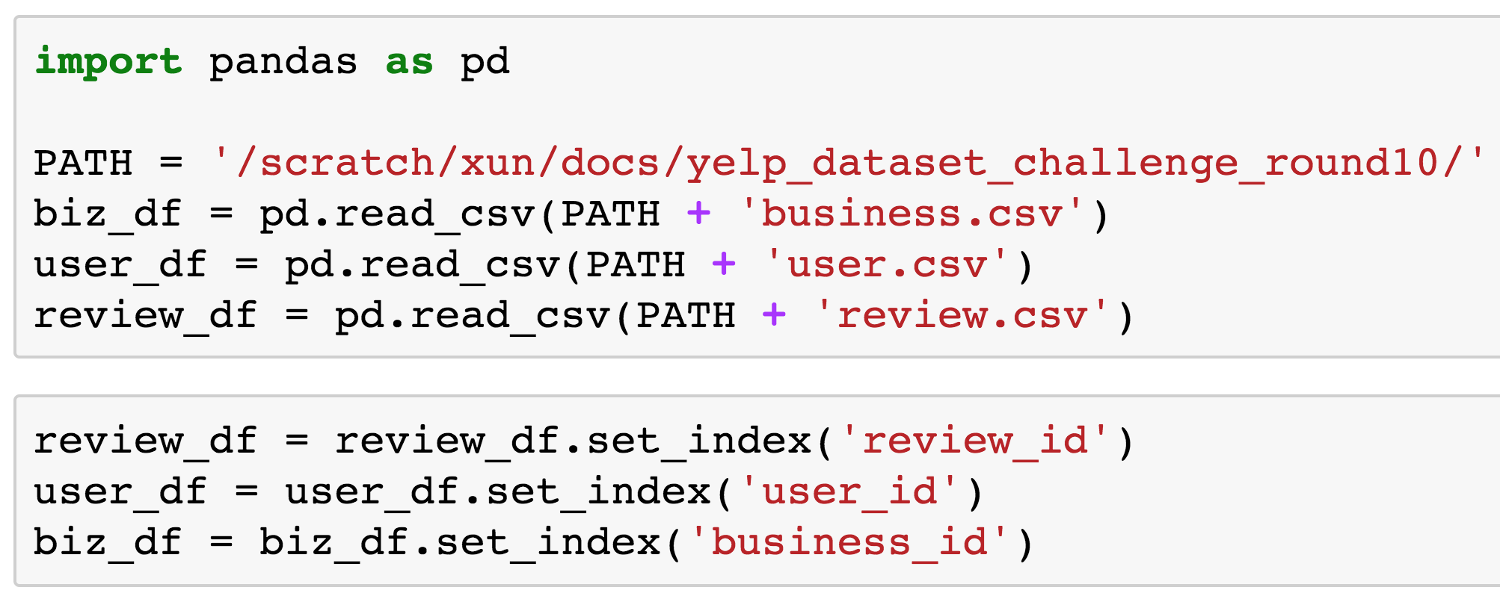
Store Data in Pandas DataFrames
Notes:
3 types of data from the dataset , each stored in a separate df
===
set_index: tells pandas to index the review df by the column named review_id

Slide 47
What’s in a Review DataFrame?
Notes:
useful function calls to get an idea of the data
what a review df looks like , after being indexed by review_id
df.head()
row each review,
columns:
review_id not in the columns (i.e. is the index)
user_id, business_id: foreign key
year
stars
df.describe()
- Generate various summary statistics, mean, max, count, etc.

Slide 48
Step 2
Explore and Visualize the Data
Notes:
one step further, better explore, usually visualize
among all the reviews available in the dataset, what percentage of them are 5 star?

Slide 49
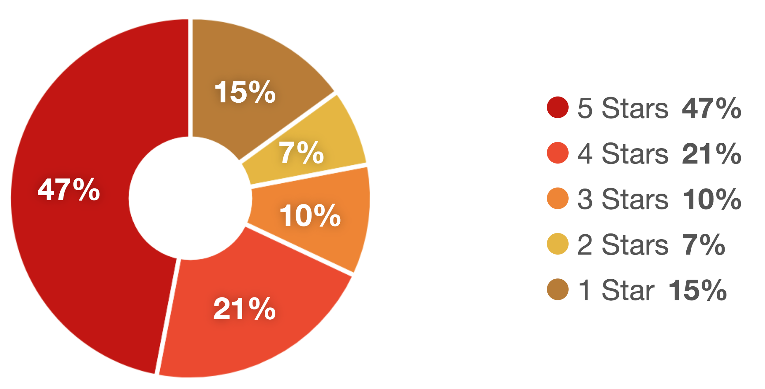
Review Star Rating Distribution Published on Yelp’s Factsheet
Source: https://www.yelp.com/factsheet
Notes:
one common mis-conception about yelp , is some folks only come to yelp to complaint about neg. experience with a biz, so most reviews should be low rating.
it’s a misconception, according to the pie graph yelp publishes on factsheet online

Slide 50
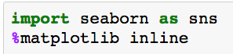
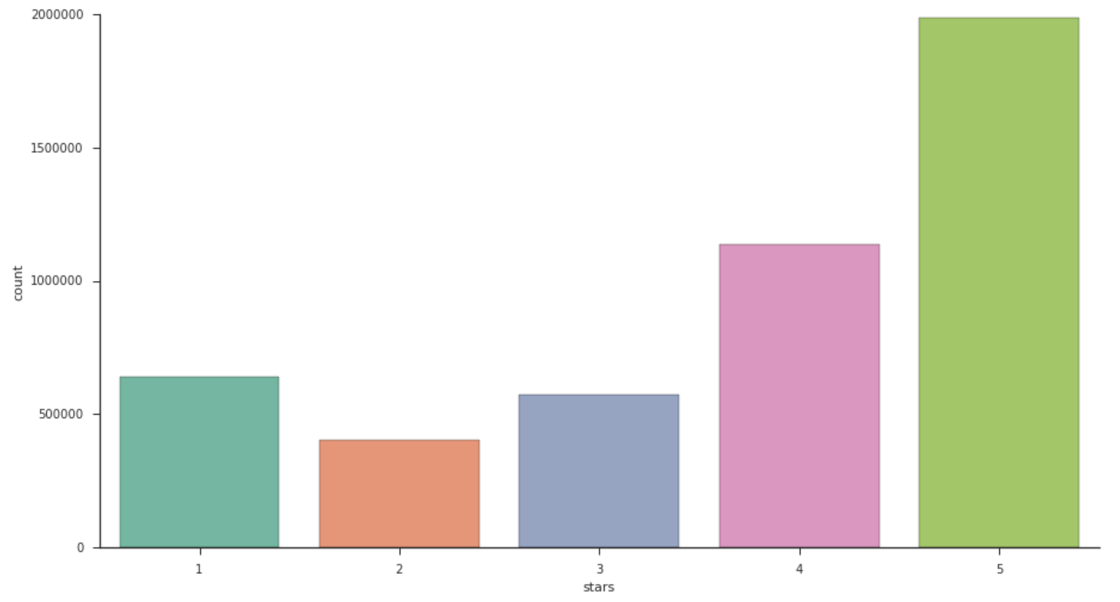
Plot Review Star Rating Distribution
from Open Dataset
Notes:
does the open dataset tell the same story?
x axis, y axis
5 stars are most common, followed by 4 star
even thou data from 12 metropolitan area, they are in sync with yelp publishes on factsheet

Slide 51
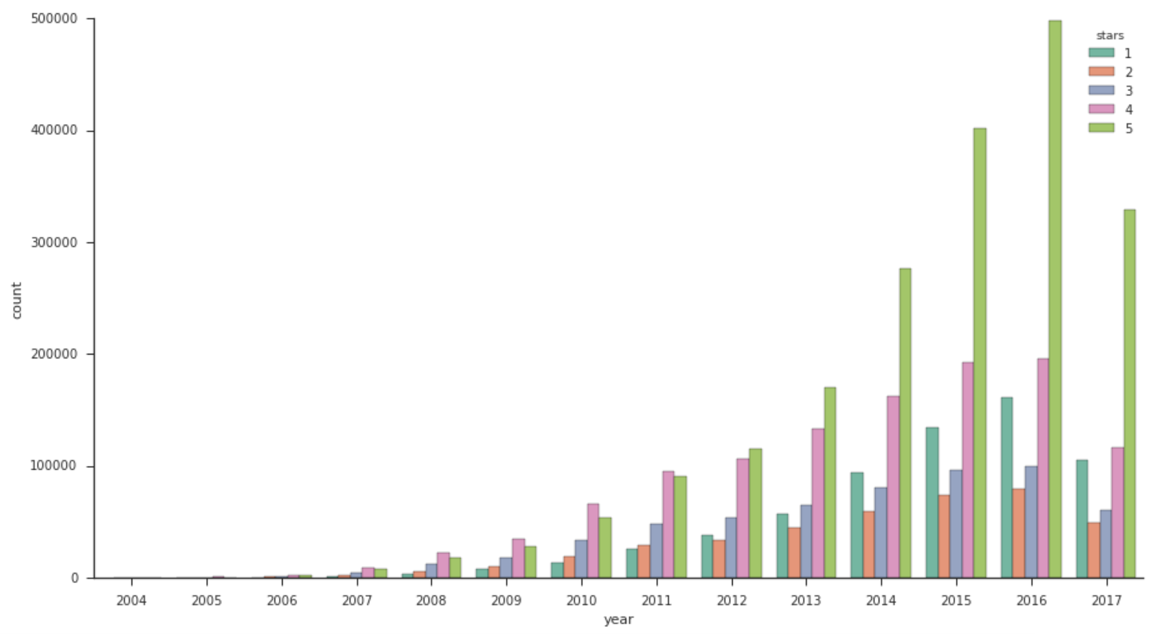
Plot Star Ratings by Year
Notes:
dive further, Plot by year: review count grow by year
how the command differs from the previous one
y-axis: unchanged, count plot, by default is the count
x-axis : stars => year (it was written)
hue parameter: add a nested categorical variable with the hue parameter, set hue = stars. becomes a nested cat within each year. so it’ll plot stars in parallel in each year
From below graph graph,
- healthy growth over the years
- on later years, there seems to be a shift towards more 5 star reviews.
visulization: find the right angle to interpret the data
many more ways, we won’t show all

Slide 52
Step 3
Generate the Features
Notes:
what’s a feature?
anything that could be used by a model to understand more about the data
many ways of representations for the same raw data, e.g. text of a review, => length of review, count of words / phrases exist the review, etc.
heavy lifting
most time consuming
80 % of the work
reasons
different training methods / algorithms may require the data to be of different format
supervised learning, hundreds or thousands of features
- real world dataset, not synthetic. data could be dirty, unexpected values, null values

Slide 53
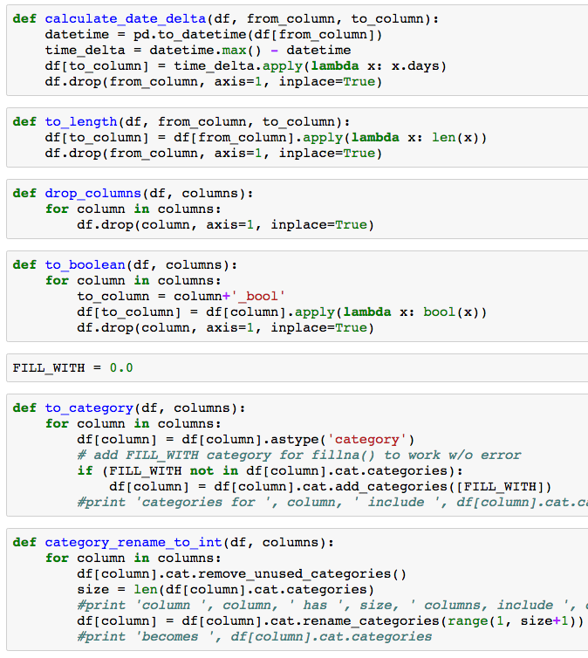
For Example..
Convert date string to date delta
e.g. business_age
Convert strings to categorical features
e.g. noise level: {‘quiet’, ‘loud’, ‘very loud’}.
Drop unused features
e.g. business_name
Notes:
Details see github

Slide 54
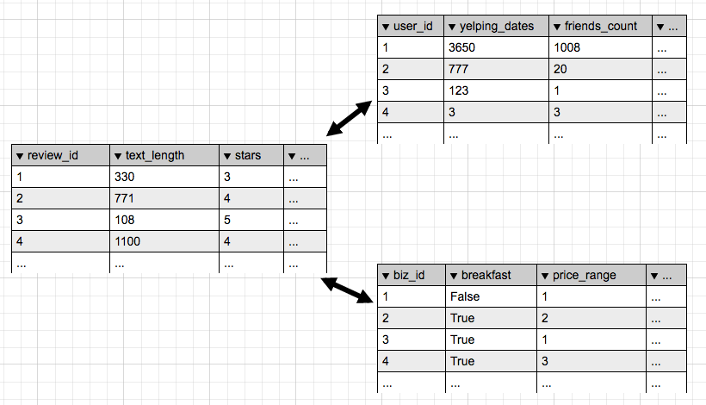
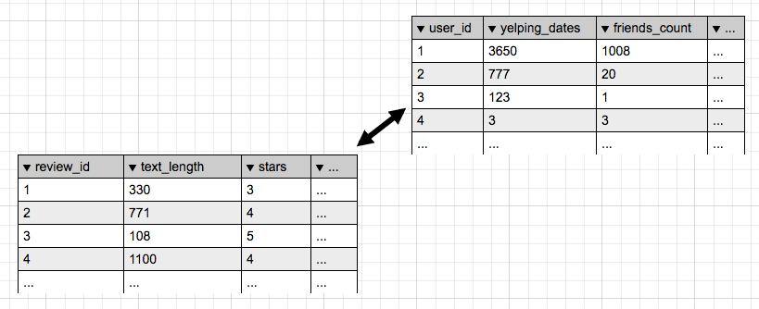
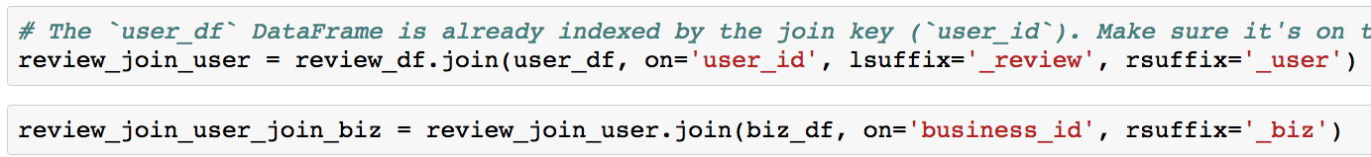
Join DataFrames to Populate the Features
User
Review
Biz
Notes:
after generate the feature within each dataframe, we join them together into one big dataframe
Each join is a many-to-one join.
similar to relational db ouster join, in review_df there are two foreign keys, user_id, biz_id
after the joins, each row represents one review, including features from the review itself, the user who’s written the review, and the business the review is for.

Slide 55
Step 4
Train a Model
Notes:
The process of training an ML model involves providing an ML algorithm (that is, the learning algorithm) with training data to learn from. The term ML model refers to the model artifact that is created by the training process.
given the features generated, come up with a math algorithm, so that it can make prediction as precise as possible

Slide 56
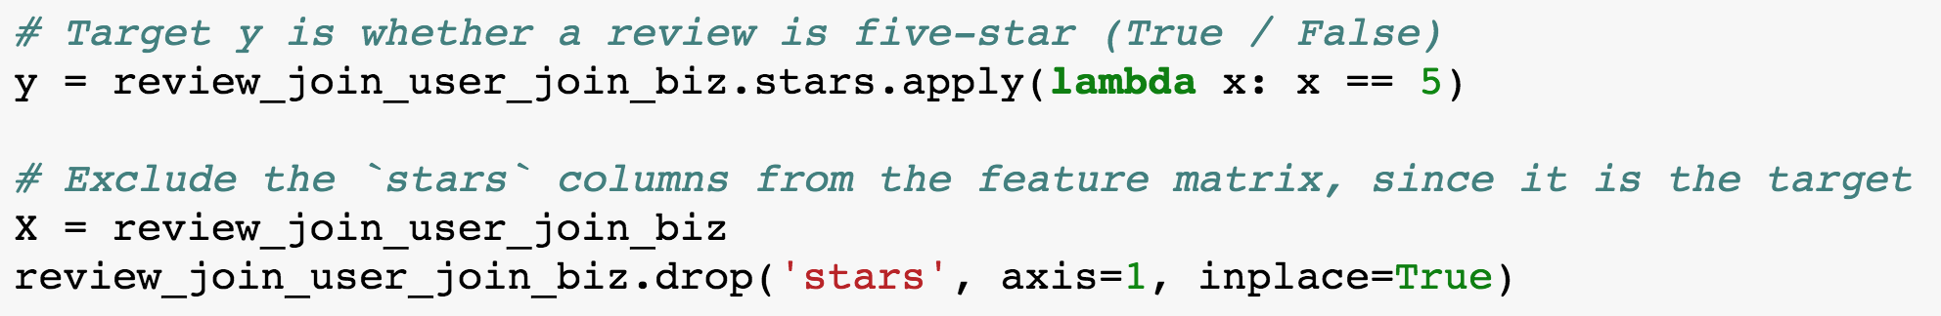
Arrange Data into a Feature Matrix and a Target Array
Feature matrix (X)
All features generated from biz, user, review dataframes
Target array (y)
What we predict: Whether the review is Five-star or not
Notes:
feature matrix: the info can be store in a two dimentional numerical array or matrix, which we call the feature matrix. by convention, the feature matrix is often stored in a variable named X.

Slide 57
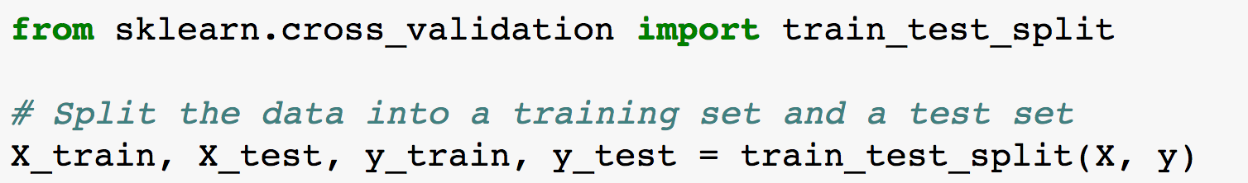
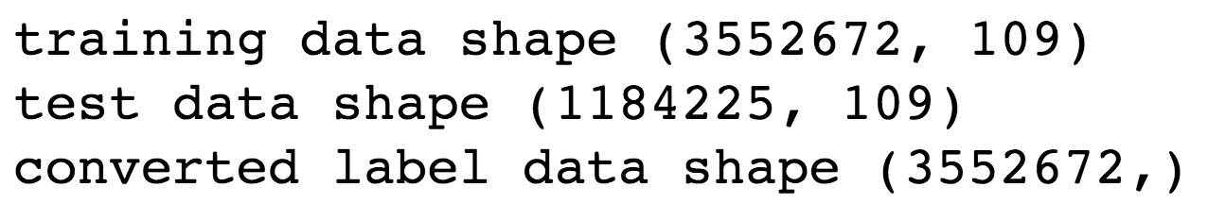
Split Training and Testing Set
Training set: used for an machine learning algorithm to train from
Testing set: used to to estimate / evaluate how well the model has been trained
Split them s.t. we don’t evaluate on the same dataset we train from

Slide 58
Model: Logistic Regression (LR)
Estimates the probability of a binary response based on the features
Here we estimate the probability of a review being five-star
Notes:
The probabilities describing the possible outcomes of a single trial are modeled using a logistic function
===
Not gonna cover:
Logistic regression
Benefits:
- Fast
- Stable
- Can handle sparse data
Disadvantages:
- Necessary to normalize data
- Data must be numeric
Parameters:
- penalty: Used to specify the norm used in the penalization ('l1' or 'l2'). Default = 'l2'.
- C: Inverse of regularization strength, smaller values specify stronger regularization. It must be a positive float. Default = 1.0.
- tol: Tolerance for stopping criteria. Default = 0.0001.

Slide 59
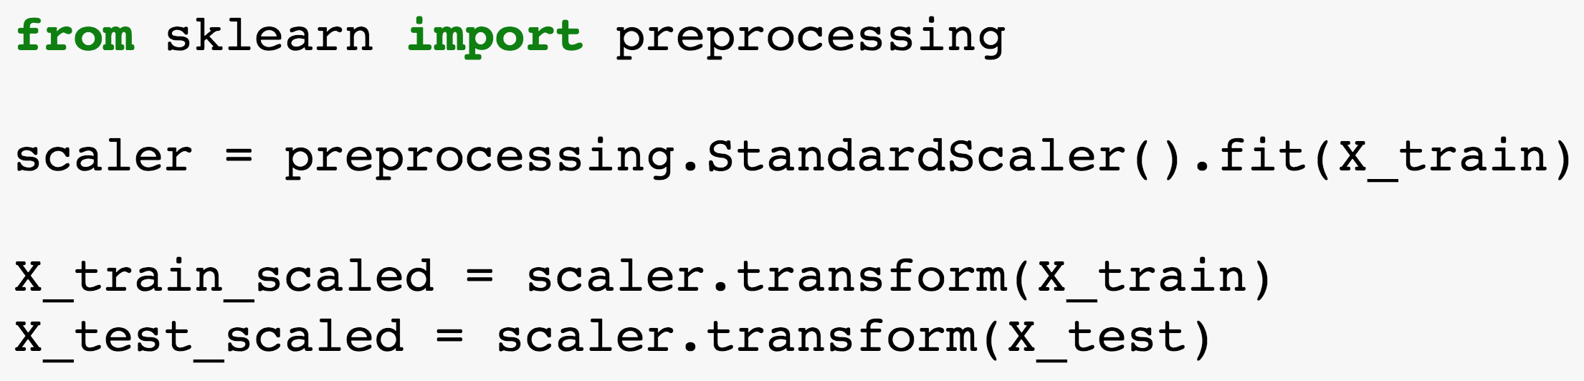
Normalize the Features
Standardize features by removing the mean and scaling to unit variance
Logistic Regression requires all features normalized

Slide 60
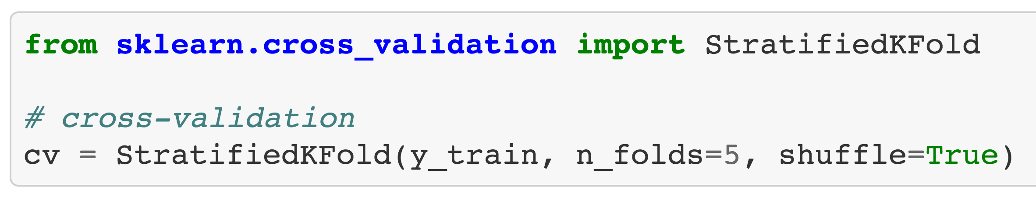
Cross Validation
Holding out a portion of the training data for model validation, and do this for `n_folds`
Ensure that the model does not overfit the training data
Select optimal model parameters

Slide 61
Step 5
Evaluate the Model
Notes:
most exciting moment in model training
done all work, now it’s the time to see how well the model is

Slide 62
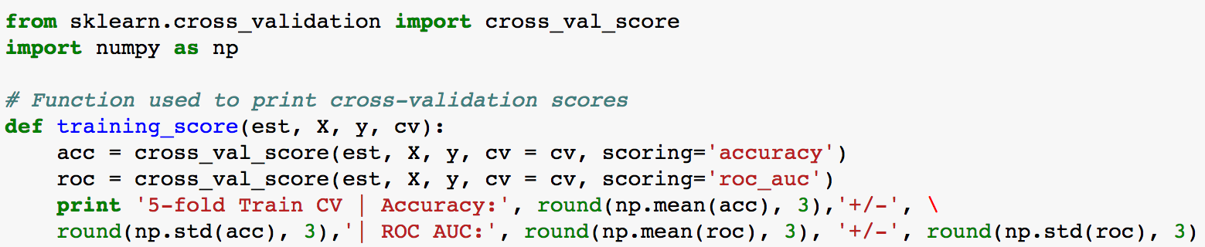
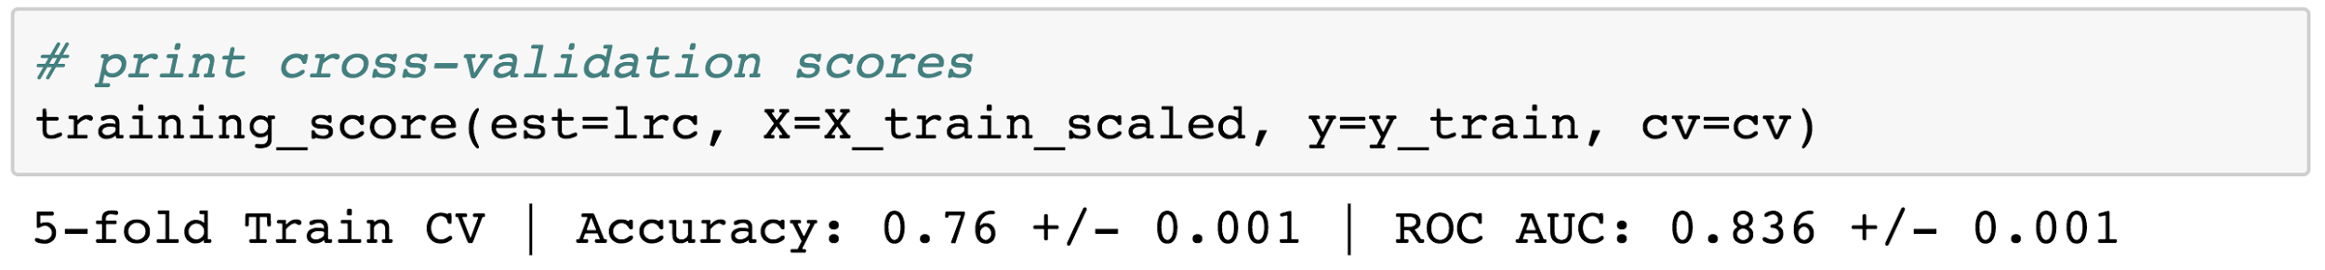
Metrics
Accuracy: Percentage of labels correctly predicted. The higher the better.
Notes:
ROC curve, is a graphical plot that illustrates the diagnostic ability of a binary classifier system as its discrimination threshold is varied.
"AUC" ("Area Under Curve”)

Slide 63
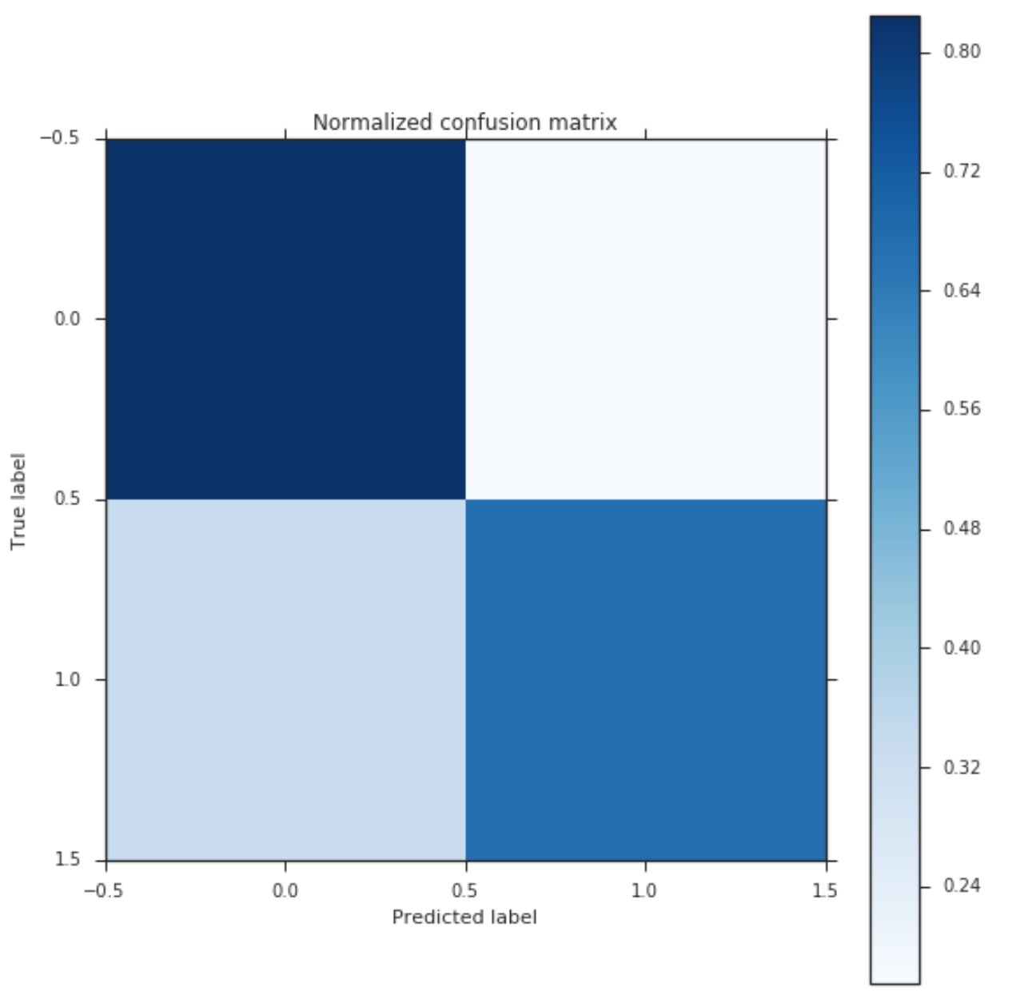
Evaluation via Confusion Matrix
True
Negative
0.82
False
Positive
0.18
False
Negative
0.33
True
Positive
(Recall)
0.67
Notes:
Since this is a classification problem
Another way to evaluate the model is to look at FP/FN
two true label, two predicted labels
4 things could happen
lower right: true positive / recall
true positive < true negative: model doing a better job at predicting a non-five-star review correctly, but worse job at predicting a five-star correctly
recall (also known as sensitivity) is the fraction of relevant instances that have been retrieved over the total amount of relevant instances.
precision (also called positive predictive value) is the fraction of relevant instances among the retrieved instances.

Slide 64
Does It Work?
Given users’ past reviews on Yelp
When the user writes a review for a business she hasn't reviewed before
Will it be a review?
Notes:
metrics are aggregated numbers

Slide 65
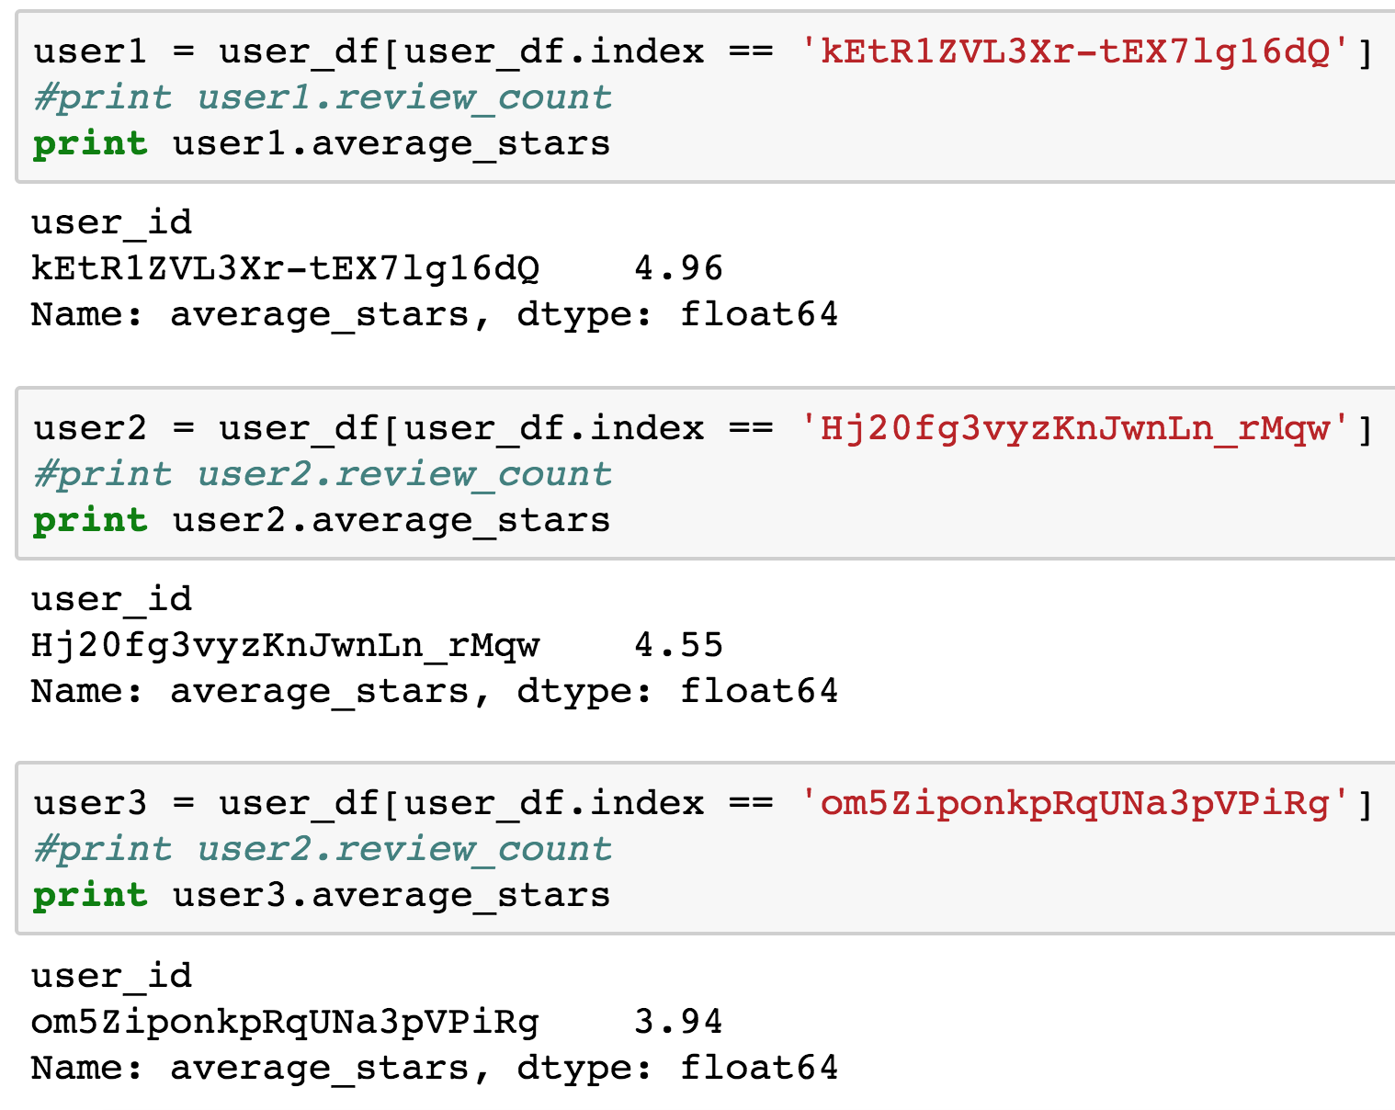
Given users’ past reviews on Yelp
Notes:
Randomly pick an anonymous user from the dataset.

Slide 66
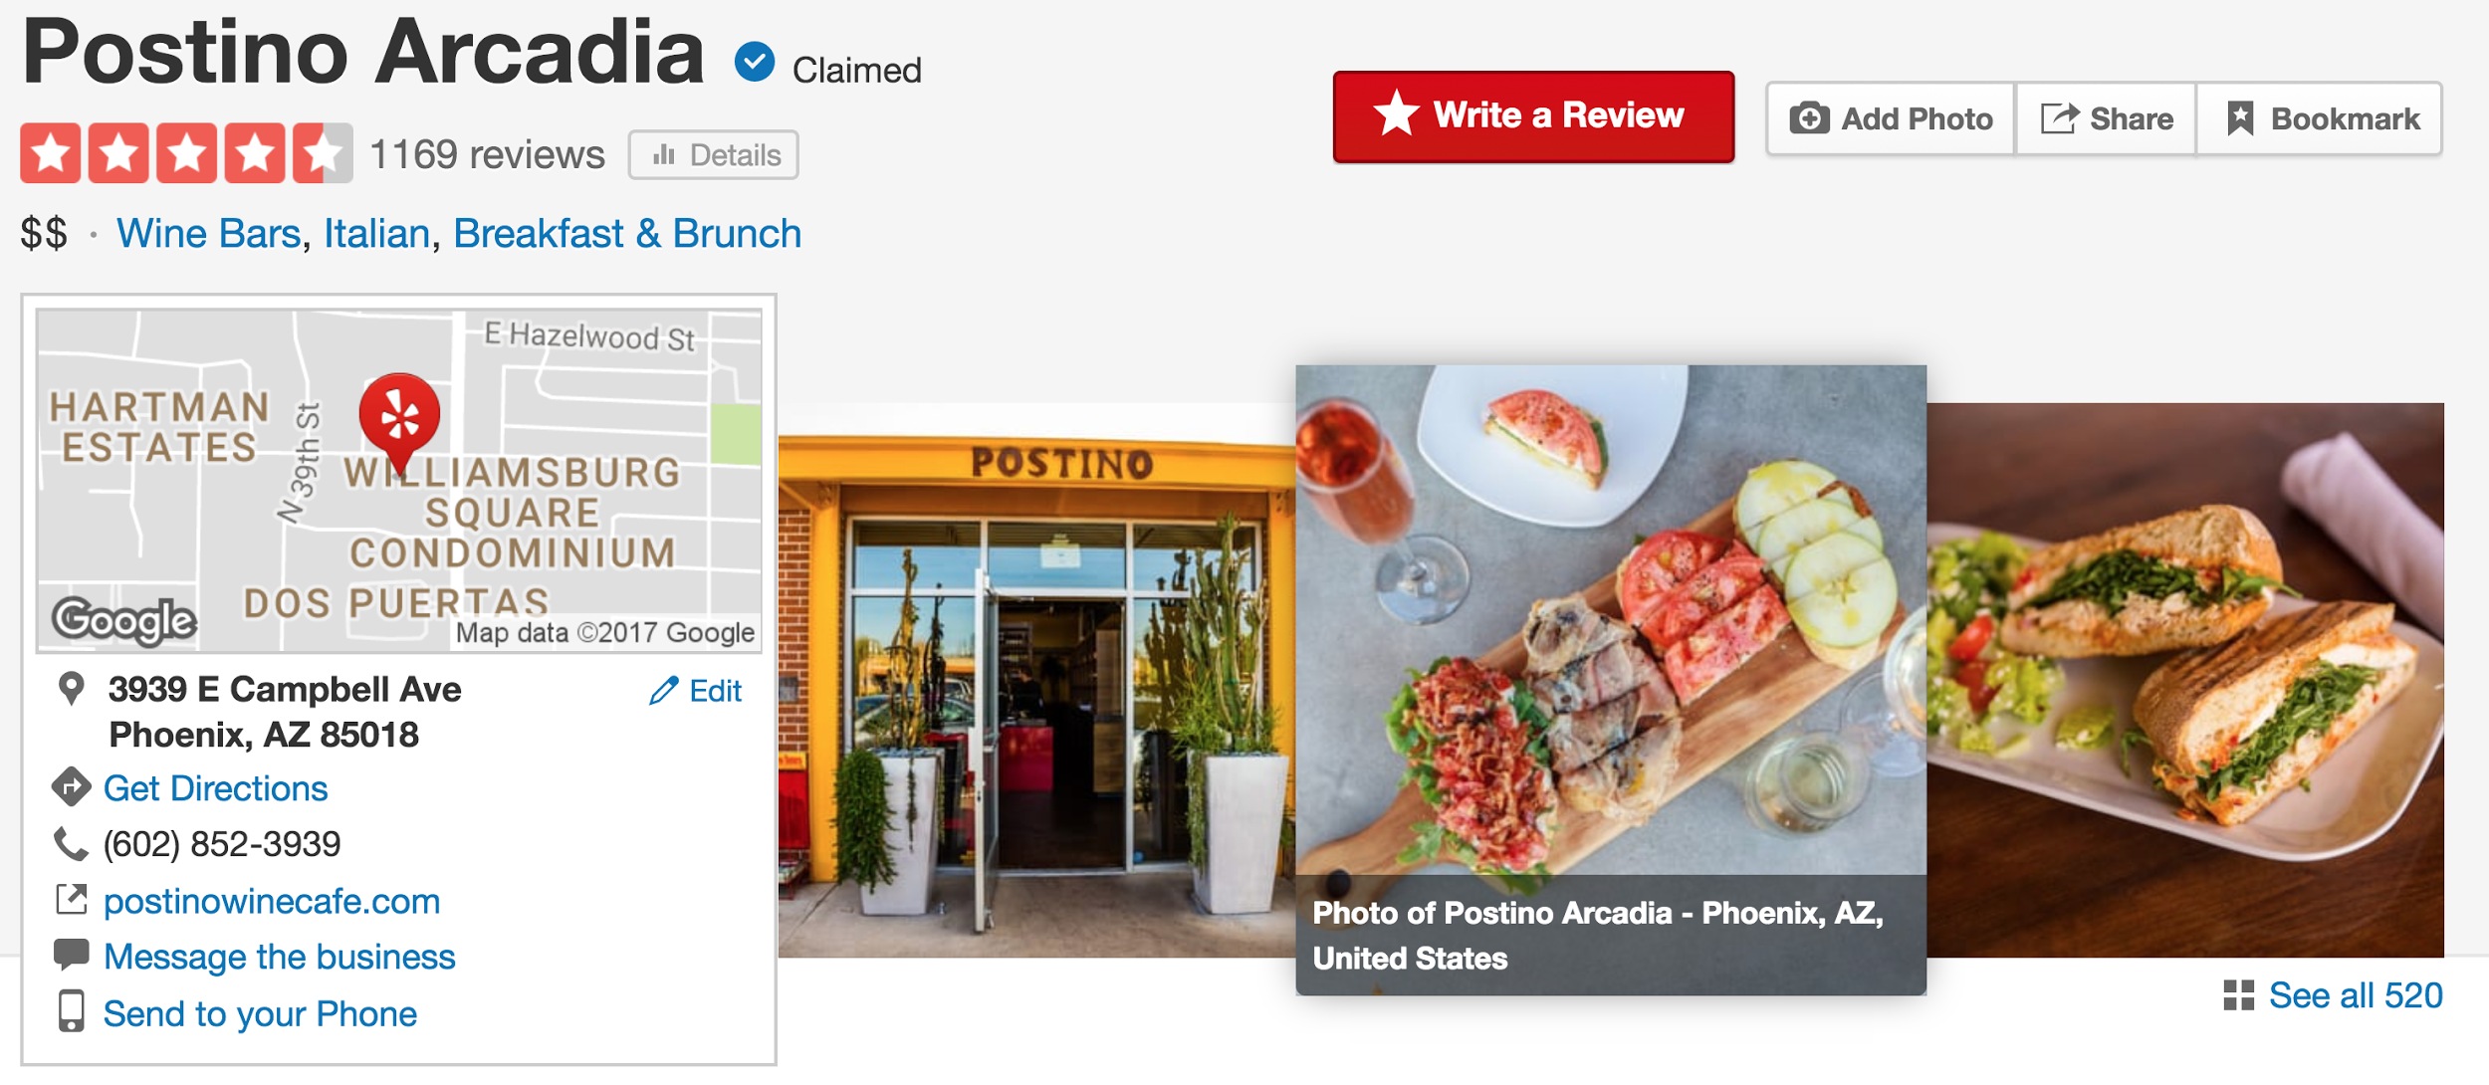
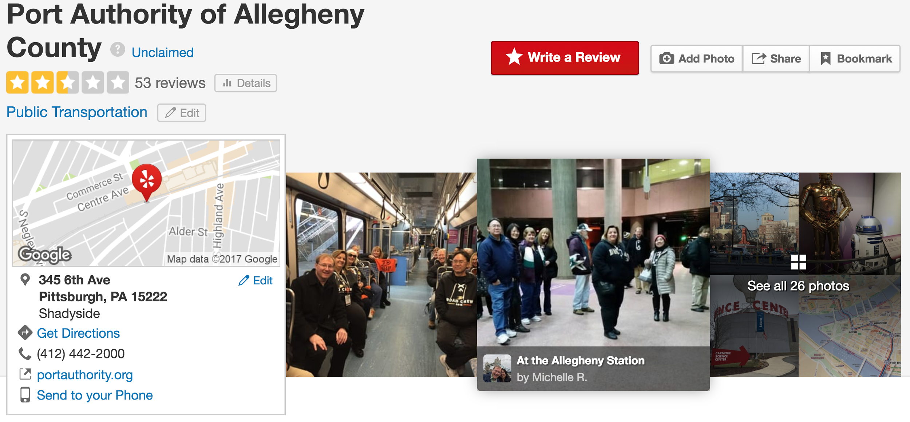
When the user writes a review for a business she hasn't reviewed before
biz1
biz2
Notes:
Randomly pick a few businesses from the dataset.

Slide 67
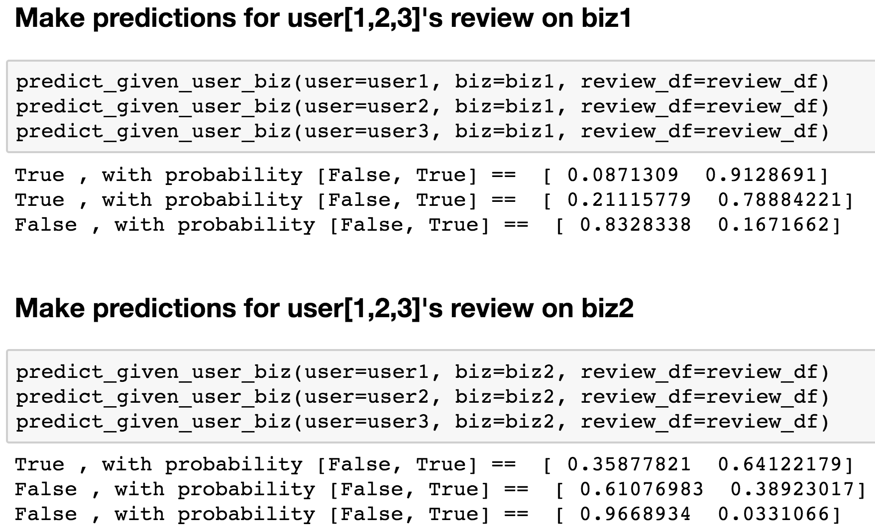
Will it be a review?
Notes:
Predict whether the user will give the business a review with five-star rating.

Slide 68
Step 6 & Beyond
Iterate Through the Process
Notes:
first trial, won’t be the best.
future rounds of iteration, look at the feature, see feature correlation, add / remove / adjust feature representation, change a model, parameter tuning model, etc.
advanced topics won’t covered today. take home: model training not one time thing, many iterations, try and error, improve

Slide 69
Yelp Dataset Challenge
Round 10
yelp.com/dataset/challenge
August 30, 2017 - December 31st, 2017
Notes:
We challenge students and professionals to use our data in innovative ways and break ground in research.
https://engineeringblog.yelp.com/2017/08/yelp-open-dataset-and-dataset-challenge-round-10.html
Our nine previous rounds have lead to a number of very exciting projects and dozens of winners.
challenge you
use the tools we introduce today
get your hands dirty
dive into real world data
use our data in innovative ways and break ground in research
trust me, it will be fun!

Slide 71
Backup Slides

Slide 72


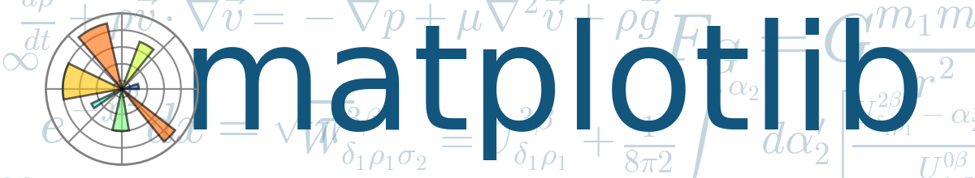


Tools
Notes:
Before start, Show hands: How many have heard of / played with scikit-learn; how many have heard about yelp-data-challenge
I will be using all tools on the slide: All tools in python, open sourced.
Pandas: data analysis tools
Seaborn: visualization library based on matplotlib
Scikit-learn: data mining and data analysis package
Jupyter Notebook (also known as ipython notebook): interactive web interface. Execute the code and view results. Easy to share
Targeted audience: developers, no ML background is ok.

Slide 73
Will Your Next Review
Be a Review?

Slide 74
Notebook & Slides
Available At
https://github.com/xun-tang/ghc_ds_workshop
Short URL: https://goo.gl/WgoeUL
Notes:
Walk thru Case study:
This demo only uses yelp open dataset
before demo: Mention code / jupyter notebook / this talk is in git repo and available

Slide 75
json -> csv
https://www.yelp.com/dataset/documentation/json
https://github.com/Yelp/dataset-examples
json_to_csv_converter:
Convert the dataset from json format to csv format.

Slide 76

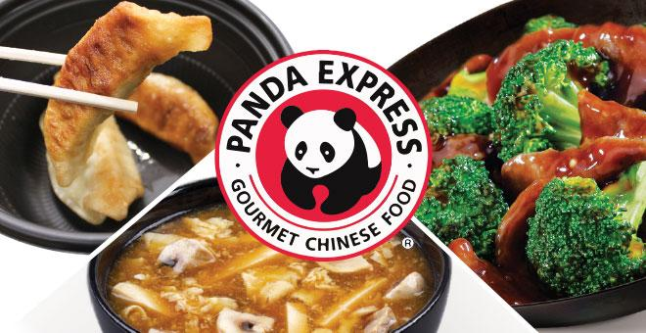
Pandas DataFrame
Pandas is great for ETL and exploration of tabular data (tsv, csv, psv format) and dictionary (or json) data
In memory data warehouse
Notes:
ETL (Extract, Transform and Load) is a process in data warehousing responsible for pulling data out of the source systems and placing it into a data warehouse.

Slide 77

Seaborn: Statistical Data Visualization
Makes visualization a central part of exploring and understanding data
Operates on dataframes
Internally performs the necessary aggregation and statistical model-fitting to produce informative plots
Notes:
https://web.stanford.edu/~mwaskom/software/seaborn/index.html

Slide 78
Questions?
Repo: github.com/xun-tang/ghc_ds_workshop
Linkedin: linkedin.com/in/xuntang
Email: xun@yelp.com
Twitter: @whoisxun
Notes:
Thank the host
b/c time limit, can’t cover all details
Draw back to what we do daily in yelp engineering team: analyze data, build model to
better connect people with great local businesses.
help user experience and yelp businesses

Slide 79
Modeling
Key methods:
fit: Fit the model according to the given training data
predict: Predict class labels for samples in data
score: Returns the mean accuracy on the given test data and labels
Notes:
While performing machine learning you do the following:
1. Training phase: you present your data from your "gold standard" and train your model, by pairing the input with expected output.
2. Validation/Test phase: in order to estimate how well your model has been trained (that is dependent upon the size of your data, the value you would like to predict, input etc) and to estimate model properties (mean error for numeric predictors, classification errors for classifiers, recall and precision for IR-models etc.)
3. Application phase: now you apply your freshly-developed model to the real-world data and get the results. Since you normally don't have any reference value in this type of data (otherwise, why would you need your model?), you can only speculate about the quality of your model output using the results of your validation phase.

Slide 80
What Model to Use?
Notes:
The process of training an ML model involves providing an ML algorithm (that is, the learning algorithm) with training data to learn from. The term ML model refers to the model artifact that is created by the training process.

Slide 81
For Example..
Decision Tree
predicts the value of a target variable by learning simple decision rules inferred from the data features
Random Forest
combines de-correlated trees, where each tree is built from a bootstrap sample and node splits are calculated from random feature subsets
Ensemble Model
combine predictions of several models in order to improve the accuracy (decrease bias) and robustness (decrease variance) over a single model
Notes:
due to time constraint, skip this & go directly to the one we use

Slide 82
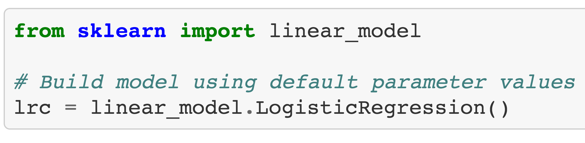
Build model

